Slide 1
WIRESHARK NETWORK ANALYSIS
Part 1
WIRESHARK ANALYZE OF MALICIOUS TRAFFIC
PRESENTED BY: SIMON THORNTON, RAJESH YELURI & BHARGAVA R THALLURU

Slide 2
Wireshark
Analyzing Malicious Traffic
Collect evidence confirming the SOC’s team intelligence
1. Time Thieves
2. Vulnerable Windows Machines
3. Illegal Downloads

Slide 3
Time Thieves

Slide 4
Time Thieves Scenario
Initial Information
At least two users on the network have been wasting time on YouTube. Usually, IT wouldn't pay much mind to this behavior, but it seems these people have created their own web server on the corporate network. So far, Security knows the following about these time thieves:
They have set up an Active Directory network.
They are constantly watching videos on YouTube.
Their IP addresses are somewhere in the range 10.6.12.0/24

Slide 5
Time Thieves Scenario
Required Information
Domain name of Users Custom Site
IP Address of Domain Controller (DC) of the AD network
Name of Malware downloaded to the 10.6.12.203 machine
Classification of malware

Slide 6
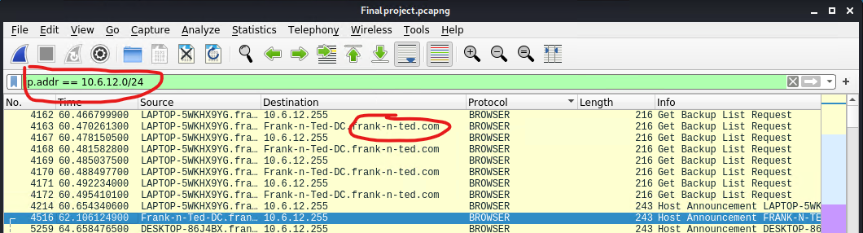
Time Thieves Scenario
Wireshark Analysis of network 10.6.12.0/24
After applying the display filter to show traffic from network 10.6.12.0/24 it is obvious that the domain name we are looking for is frank-n-ted.

Slide 7
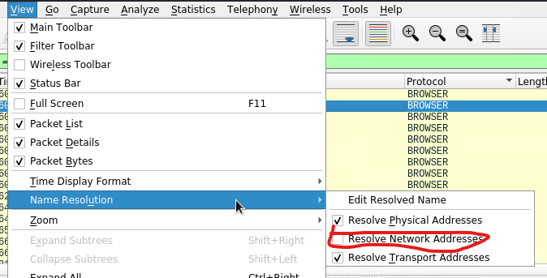
Time Thieves Scenario
Finding the Address of the domain controller

Slide 8
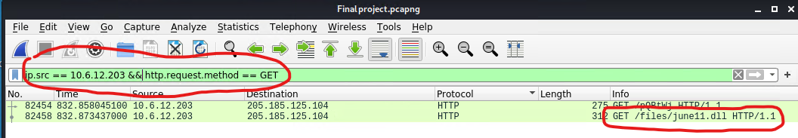
Time Thieves Scenario
Finding the malicious file with wireshark
It was assumed that the user has downloaded the file with http
An appropriate filter was applied
june11.dll is a known malicious file which can be checked in Virustotal.com

Slide 9
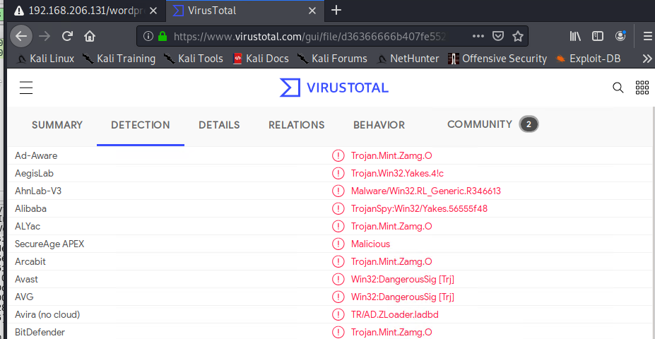
Time Thieves Scenario
Using Virustotal.com to check virus type.
File can be extracted from wireshark and uploaded to Virustotal.com
Notes:
Check for associated http status = 200 (by following TCP Stream) to find the actual file. Right click on the data field and Export Packet Bytes.

Slide 10
Vulnerable Windows Machines

Slide 11
Vulnerable Windows Machines
Initial Information
The Security team received reports of an infected Windows host on the network. They know the following:
Machines in the network live in the range 172.16.4.0/24.
The domain mind-hammer.net is associated with the infected computer.
The DC for this network lives at 172.16.4.4 and is named Mind-Hammer-DC.
The network has standard gateway and broadcast addresses.

Slide 12
Vulnerable Windows Machines
Required Information
Information about the infected Windows machine, Host Name, IP address, MAC address
Username of the Windows user whose computer is infected
The IP addresses used in the actual infection traffic
The desktop background of the Windows host

Slide 13
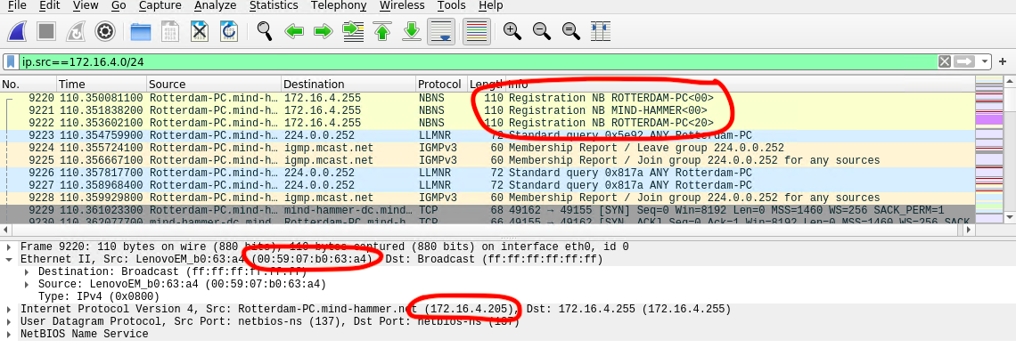
Vulnerable Windows Machines
Finding information about infected windows machine
After applying the display filter to show traffic from network 172.16.4.0/24
Host Name: Rotterdam-PC
IP Address: 172.16.4.205
MAC Address: 00:59:07:bo:63:a4

Slide 14
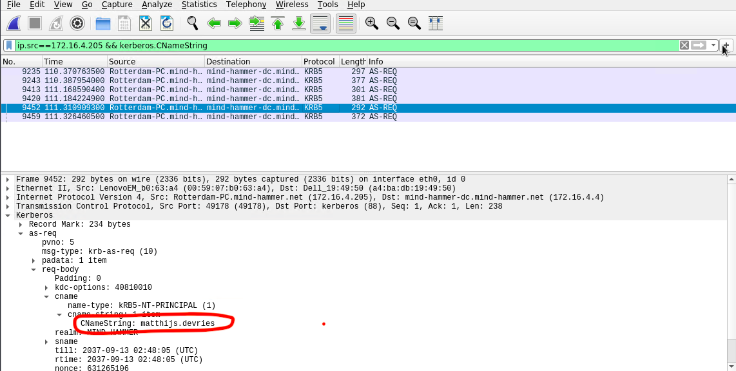
Vulnerable Windows Machines
Finding the username of Windows user whose computer is infected
As we know the IP address of the machine which is infected, after applying the display filter ip.src==172.6.4.205 && Kerberos.CNameString, found the username: matthijs.devries

Slide 15
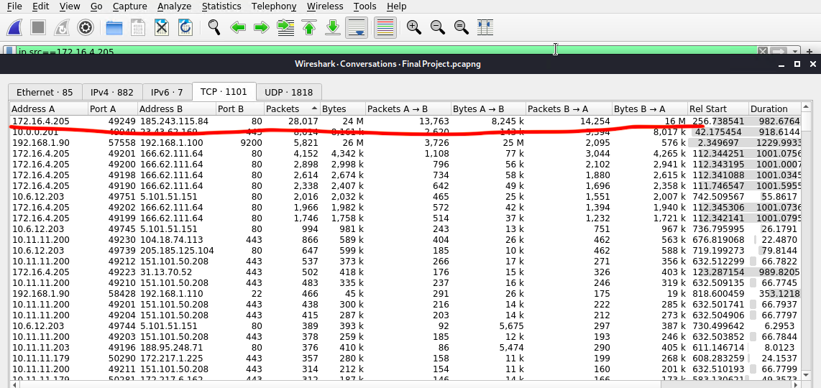
Vulnerable Windows Machines
The IP addresses used in the actual infection traffic
The IP address used in infection is 185.243.115.84, highest number of packets transferred from this IP only

Slide 16
Vulnerable Windows Machines
The desktop background of the Windows host
After applying the display filter to show png from ip addr==172.16.4.205

